Slide 1
Stochastic Low Rank Latent Bandits (Research Intern Project Exit Talk)
Subhojyoti Mukherjee (Branislav Kveton, Anup Rao, Zheng Wen)
Adobe Research (STL/BEL) | 19-Apr-2018

Slide 2
Something about me
Current: 3rd year Computer Science M.S student at Indian Institute of Technology Madras (submitted thesis). I will be joining CS PhD at UMass Amherst, Fall 2018.
Research focus area(s): reinforcement learning, multi-armed bandits
My contact outside Adobe – subho@cse.iitm.ac.in, subhojyotimukherjee22@gmail.com
I have worked on several interesting areas in multi-armed bandits:-
Thresholding bandits with Augmented UCB (accepted at IJCAI 2017)
Efficient UCBV: An Almost Optimal Algorithm using Variance Estimates (accepted at AAAI 2018)
3-month Internship at INRIA, SequeL Lab, Lille France under Odalric-Ambrym Maillard.
Improved Changepoint Detection in Piecewise Stochastic Bandits (under review at ICML 2018).

Slide 3
Online Learning
Why Online Learning?
Limited previous data about the users (cold-start problem).
Adapting to changing preferences of users.
Changing context of the items.
To solve this complex problem we need a learner which is :
Adaptive
Fast
Intelligent

Slide 4



Online Learning Setting
A pool of users
A list of items (arms)
The learner

Slide 5
Online Learning Game
At each timestep t, Nature chooses a user i_{t}.
The learner chooses a set of items B_{t} and |B_{t}| = d.
The user can choose upto d items in B_{t} and the feedback is revealed to the learner.
Learner modifies its suggestion for the user i_{t} on receiving the feedback.

Slide 6


Latent Bandit Game
At each timestep t, Nature chooses a user i_{t}.
The learner chooses a set of items B_{t} and |B_{t}| = d.
The user can choose upto d items in B_{t} and the feedback is revealed to the learner.
Learner modifies its suggestion for the user i_{t} on receiving the feedback.
It can learn faster if it leverages the latent structure about the groupings of users
Users are grouped into clusters, unknown to the learner

Slide 7
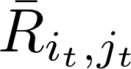
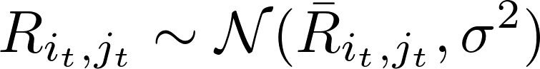
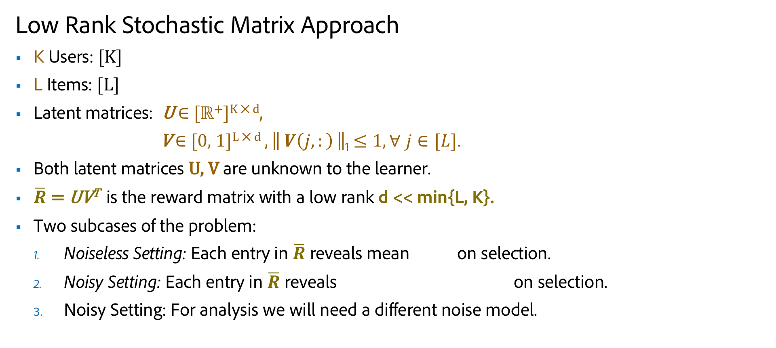
Problem Definition
Low Rank Stochastic Matrix Approach
K Users: [K]
L Items: [L]
Latent matrices: U $∈$ [ℝ⁺]^{K ⨉ d},
V $∈$ [0, 1]^{L ⨉ d} , || $V\left(j,:\right)$||₁ $≤1, ∀ j∈[L]$.
Both latent matrices U, V are unknown to the learner.
$\overline{R}$ = UV^{T} is the reward matrix with a low rank d << min{L, K}.
Two subcases of the problem:
Noiseless Setting: Each entry in $\overline{R}$ reveals mean on selection.
Noisy Setting: Each entry in $\overline{R}$ reveals on selection.
Noisy Setting: For analysis we will need a different noise model.

Slide 8
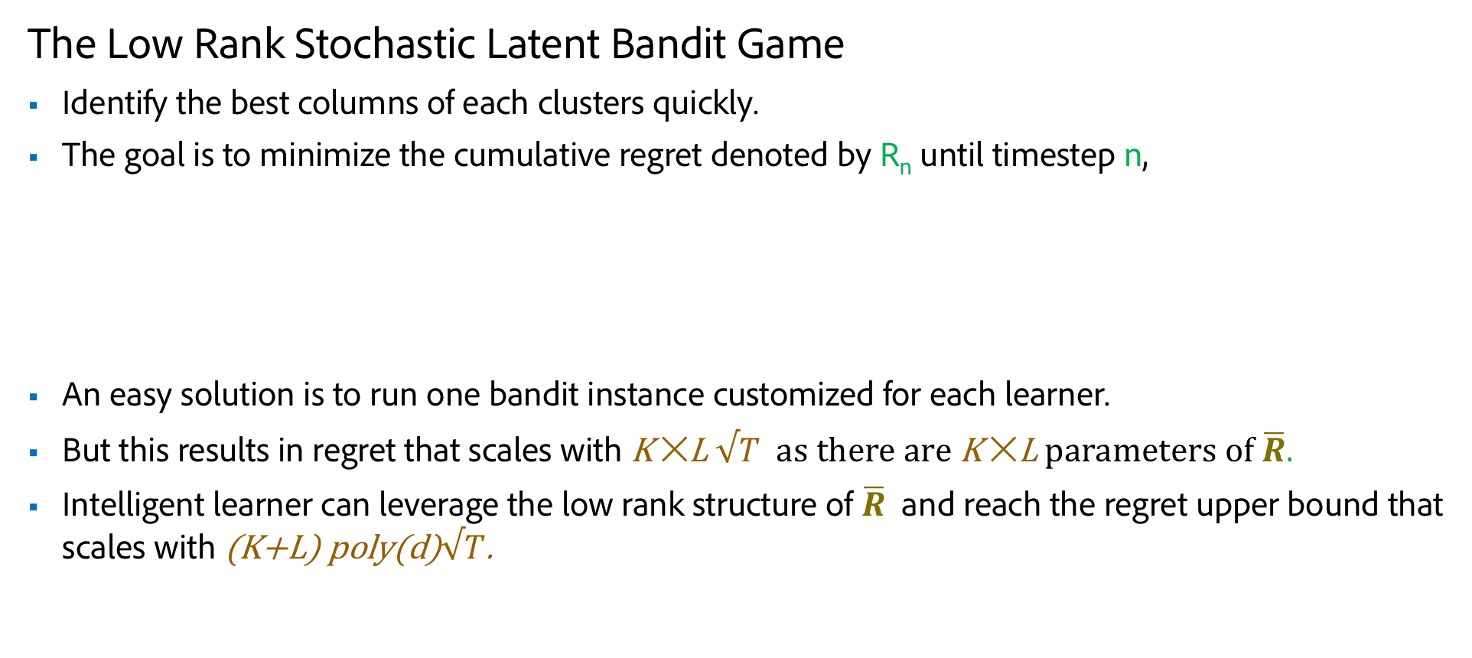
Goal of the Learner
The Low Rank Stochastic Latent Bandit Game
Identify the best columns of each clusters quickly.
The goal is to minimize the cumulative regret denoted by R_{n} until timestep n,
An easy solution is to run one bandit instance customized for each learner.
But this results in regret that scales with K $✕$L $√T$ as there are K $✕$L parameters of $\overline{R}.$
Intelligent learner can leverage the low rank structure of $\overline{R}$ and reach the regret upper bound that scales with (K+L) poly(d)$√T$.

Slide 9
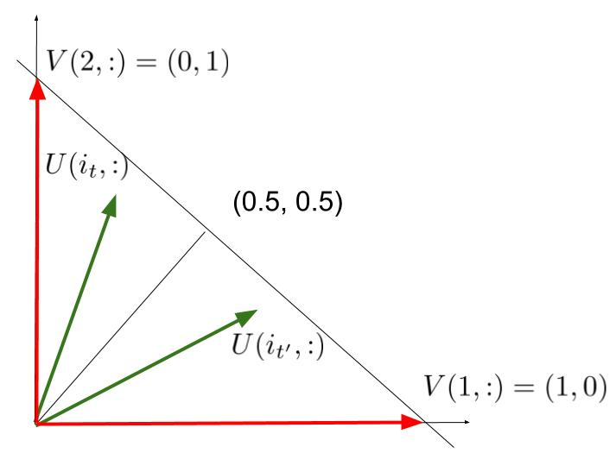
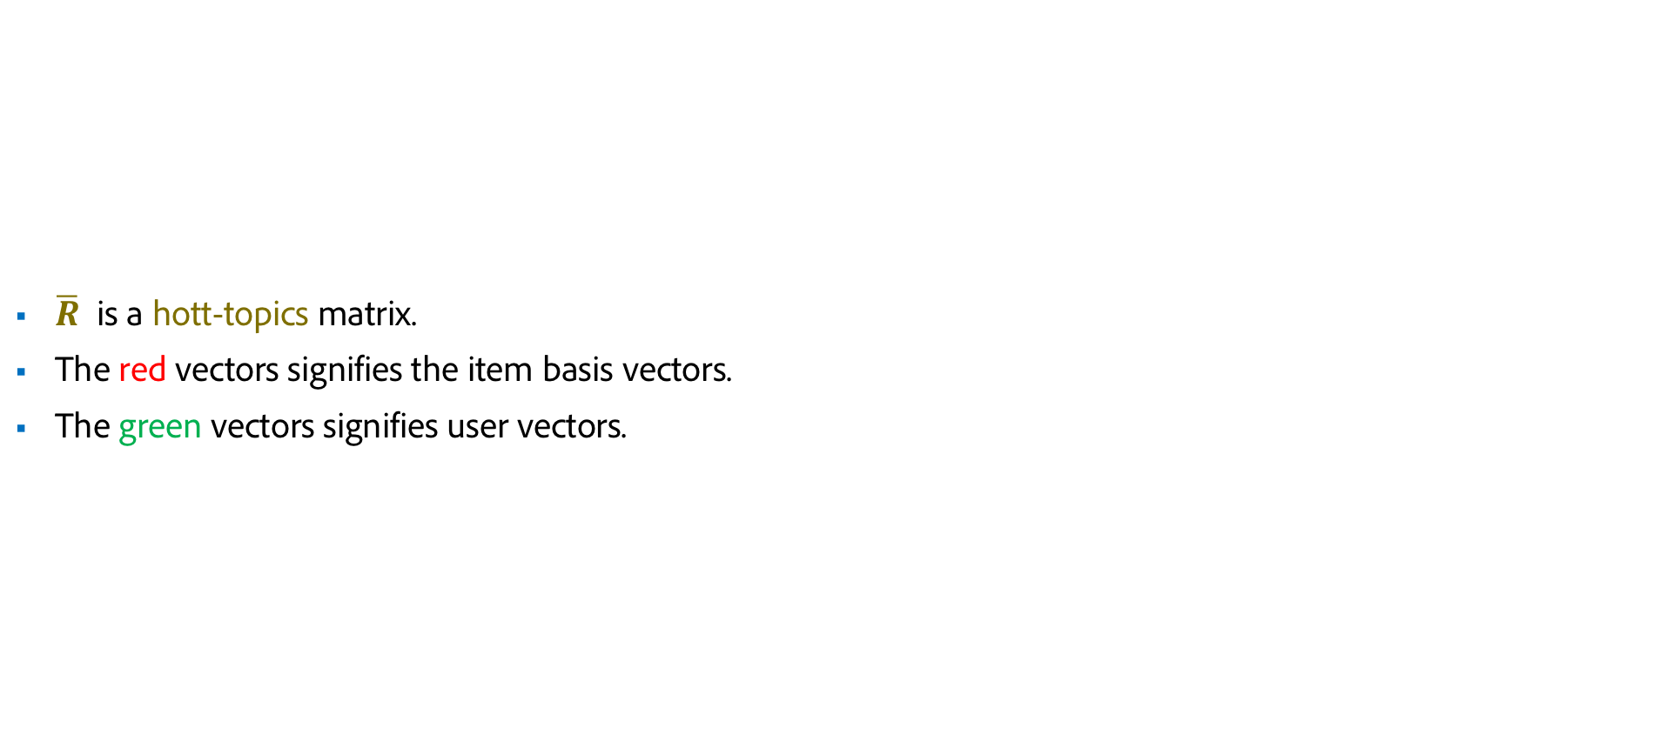
A Simple Example
$\overline{R}$ is a hott-topics matrix.
The red vectors signifies the item basis vectors.
The green vectors signifies user vectors.

Slide 10
Ranking and Online Sub-modular maximization
We found the connection to the ranking literature of Radlinski et al (2008) which is a special case of online sub-modular maximization problem.

Slide 11
Ranking and Online Sub-modular maximization
We found the connection to the ranking literature of Radlinski et al (2008) that because of the hott-topics assumption ranking d-best columns and our setting are quite similar.
WLOG, in the noiseless setting we can consider that the first as the best set of columns.
Then because of the hott-topics assumption we have that the j-th best column in [d] is given by the estimation:-
For noisy setting, we have to feed the noisy reward to the estimators in such a way that this property is maintained.

Slide 12
Meta Bandit Strategy for Rank d
d copies of Column-Bandits tries to figure out the d best columns.
K User Bandits tries to figure out the best item for each user

Slide 13
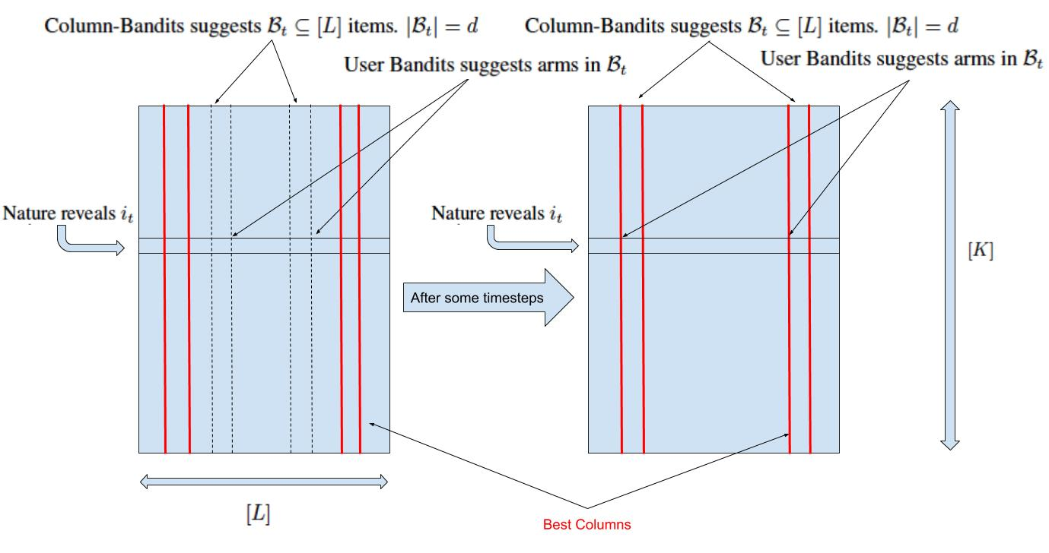
Meta Bandit Strategy, Rank d=2 example

Slide 14
Bandit Feedback and Exploration
Our setting deals with Bandit Feedback and only observes the feedback of user-item pair selected by the user.
To maintain the online sub-modular maximization structure of feeding the rewards, we need to select at least d items per user during exploration.
OR wait for the user to select atleast d different items till some arbitrary timestep and then update the d Column-Bandits.
The simple work-around against this combinatorial explosion is to explore at some fixed rate by suggesting d different items to the user and record the feedback.
AND exploit rest of the timesteps to minimize cumulative regret.

Slide 15
Column Bandit EXP3
We use Exponential weighting with Exploration and Exploitation strategy for Column-Bandits.
It uses a mixture of exponential weighting and uniform exploration to create a probability distribution over the items.
Then it suggests one item by sampling from the distributions of the items.
It updates the weights after observing the feedback.

Slide 16
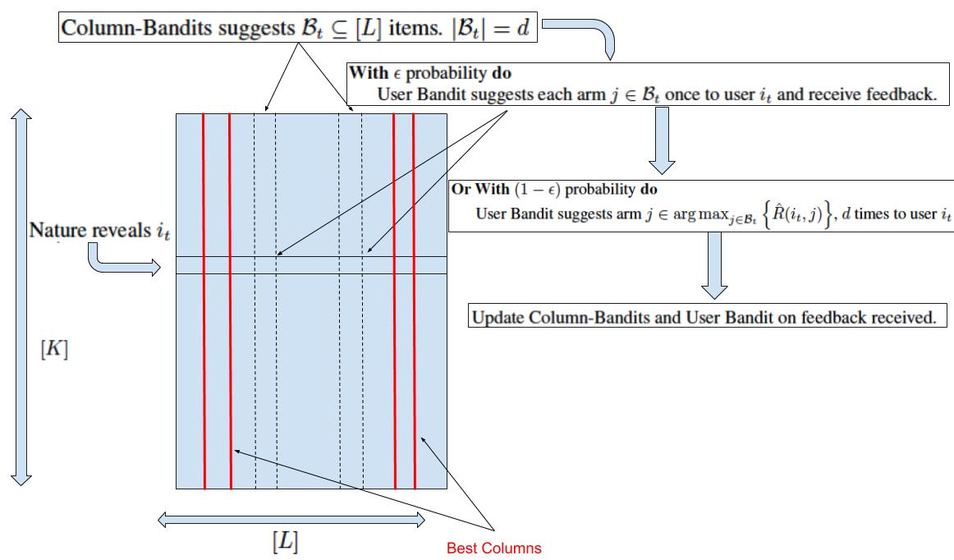
Low Rank Greedy (LRG) Algorithm
is used for exploration.
The user experts are greedy.

Slide 17
Meta bandit Greedy Strategy
is used for exploration.
The user experts are greedy.

Slide 18
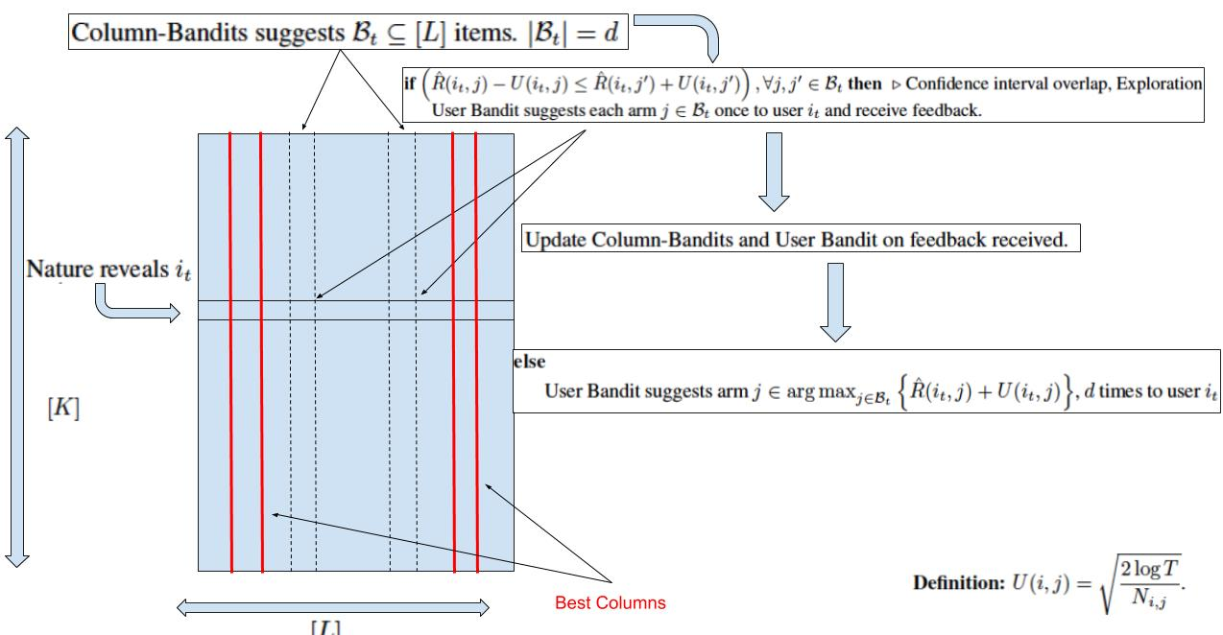
Low Rank UCB (LRUCB) Algorithm
Use UCB elimination strategy from Auer and Ortner (2010) to stop exploration.
Use UCB1 strategy for users.

Slide 19
Meta Low Rank Bandit
Use UCB elimination strategy from Auer and Ortner (2010) to stop exploration.
Use UCB1 strategy for users.

Slide 20
Comparison between LRG and LRUCB
LRG conducts exploration till the end of time horizon.
LRUCB stops exploration after the Column-EXP3 starts focusing on the d-best columns.
Regret Guarantees exist for LRG but not for LRUCB.

Slide 21
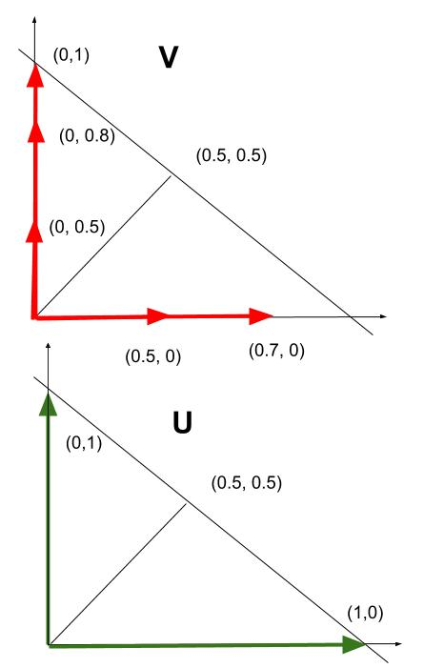
Experiment 1, Equal Cluster

Slide 22
Experiment 2, Unequal Cluster
V =
U =

Slide 23
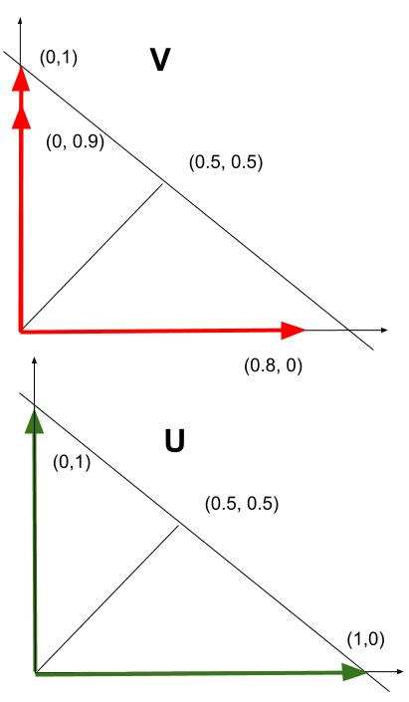
Experiment 3, Equal Cluster

Slide 24
Experiment 4, Un-equal Cluster

Slide 25
Related Works
Difference with Latent Bandits (Maillard and Mannor, 2014)
K users divided into |B| clusters such that the reward distributions of all the users in each of the clusters are identical.
This problem easier to solve and has less practical applications.
The general Agnostic-UCB algorithm does not have regret guarantees.
Difference with Stochastic Rank-1 Bandits (Katariya et al., 2017)
In this setting at every timestep the learner chooses a pair of user and arms.
No inherent grouping exist amongst the users.
A complicated phase based Column Elimination Algorithm is used to eliminate sub-optimal columns.

Slide 26
Related Works
Difference with Stochastic Low-Rank Bandits (Kveton et al., 2017)
In this setting at every timestep the learner chooses d-subsets of user and arms.
No inherent grouping exist amongst the users.
Has the hott-topics assumption on both users and item matrix.
A complicated phase based Column Elimination Algorithm which uses the costly determinant (volume) estimation to eliminate sub-optimal columns.
Difference with NMF-Bandits (Sen et al., 2017)
Uses the Restricted Isometric Property (RIP) assumption on the reward structure.
Regret guarantee scales with polynomial of rank over gap-square.
Guarantees does not hold for general real-life matrices and difficult to analyze without RIP.

Slide 27
Related Works
Difference with Latent Bandits (Maillard and Mannor, 2014)
K users divided into |B| clusters such that the reward distributions of all the users in each of the clusters are identical.
This problem easier to solve and has less practical applications.
The general Agnostic-UCB algorithm does not have regret guarantees.
Difference with NMF-Bandits (Sen et al., 2017)
Uses the Restricted Isometric Property (RIP) assumption on the reward structure.
Regret guarantee scales with polynomial of rank over gap-square.
Guarantees does not hold for general real-life matrices and difficult to analyze without RIP.

Slide 28
Related Works
Difference with Low-rank Bandits with Latent Mixtures (Gopalan et al., 2016)
In this setting at every timestep the learner chooses each user atleast 3 times (mini-session).
Uses Robust Tensor Power (RTP) estimation on noisy matrices to recover the columns which is a costly operation as it requires calculation of L ✕ L and L ✕ L ✕ L matrices.
RTP on noisy matrices requires the assumption that the minimum and maximum singular value is always greater than zero or a positive constant.
Novelty of our approach
We do not require determinant (volume) estimation or calculate large square matrices.
We do not require the RIP property.
We do not require the minimum or maximum singular value restriction as we are not doing column reconstruction.
We require hott-topics on V.

Slide 29
Conclusions and Future directions
We proposed one meta algorithm with different types of exploration to solve the Stochastic Low rank Latent Bandit problem.
We assumed minimal assumptions on the reward structure and only modified the number of item selection per user.
We provide regret guarantees for MLRG algorithm.
Currently, no regret guarantees exists for the best performing algorithm MLRUCB.
MetaEXP3 can be modified to include implicit exploration from Kocak et al 2014 for better performance.

Slide 30
Timeline
Week 1-3
Define problem statement
Literature review
Present inception talk
Week 4-6
Develop and analyze algorithm for the noise-free setting
Regret upper bound for the noise-free setting
Develop algorithm for the noisy setting
Week 7-10
Regret upper bound for the noisy setting
Experiments with other state-of-the-art algorithms
Week 11-13
Prepare paper for submission (NIPS)

